Slide 1

18-738 Lightning talk
‘hitoe’ wearable shirt sensor for formula-1 drivers
- Uday sriram

Slide 2
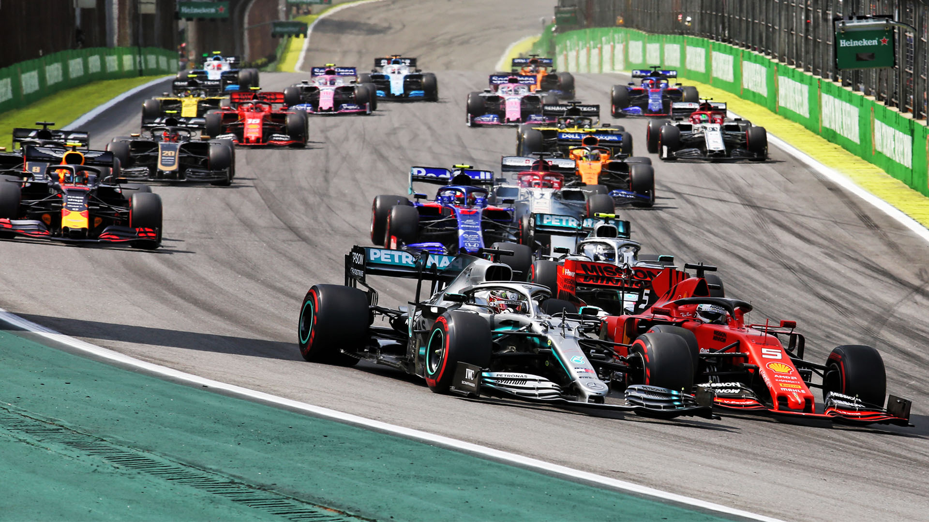
overview
Formula 1 and its impact on drivers
Alternate Biometric technologies in formula 1: cosinuss monitor and biometric gloves
Hitoe sensor shirt (focus of this presentation)
Hitoe application to formula 1
Conclusion and opinion

Slide 3
Formula 1
305 km race
Up to 2 hours long
Cars can go up to 375 km/hr (234 mi/hr)
Cars reach 0-100 km/hr in around 2.5 seconds
Cars Brake from 100-0 km/hr at the same time

Slide 4
Strain on f1 drivers
Centrifugal forces and heat in the cockpit
Massive forces of up to 4g in wide turns and 6g in narrow turn braking
Drivers burn up to 3000 calories and lose 4 kg of weight after an average length race
Psychological factor: stress and competitiveness
- this places heavy strain on the driver’s heart for up to 2 whole hours.
- Average driver Heart rate is around 170 bpm but can go up to 210 bpm
- Prolonged fast heart rates can cause damage to the cardiovascular muscles if not analyzed properly

Slide 5
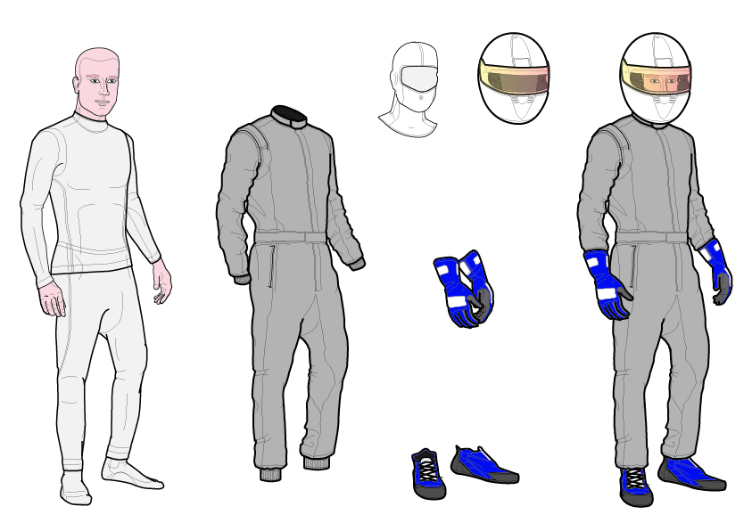
F1 driver suit
Long sleeve top
Longjohns
Balaclava (hood)
Kevlar helmet with foam lining and ballistic visor
All of the above are made of a fire-proof material called nomex
Nomex: m-phenylenediamine and isophthaloyl chloride

Slide 6
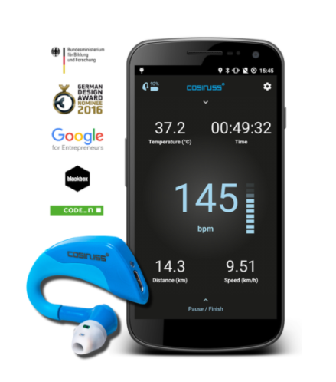
Cosinuss performance monitor
Ear device worn underneath f1 helmet
Contains a pulse rate scanner, gyroscope, and thermometer
4 cm x 4 cm, 6.5 grams
Measures heart rate, body temperature, and 3d acceleration
Uses Bluetooth or ant+ for communication
However, this technology can be a little invasive and uncomfortable

Slide 7
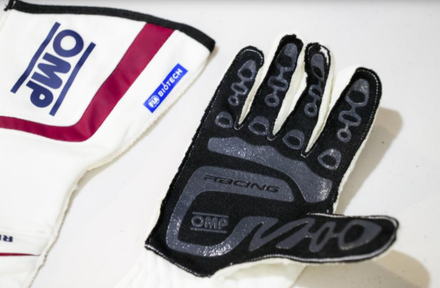
Biometric gloves
Gloves with flexible 3 mm sensor worn by drivers to monitor live biometric data
reports pulse rate and blood oximetry to the medical staff
Works via Bluetooth with a 500 m radius around the car
Wireless charging enabled
Temperature and breathing rate to be added in the future

Slide 8

Hitoe – what is it?

Slide 9
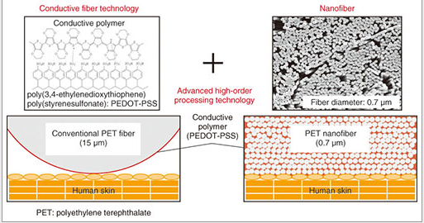
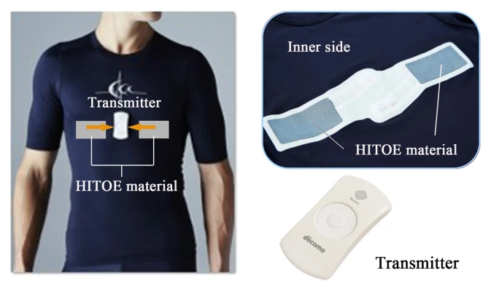
Hitoe technology
Electro-conductive polymer nanofiber material Developed by Japanese engineers
Coated with pedot-pss polymer on a 0.7 micrometer diameter fabric
Capable of measuring biomedical signals such as electrocardiogram, breath, skin ph, and muscle contractions
Can be embedded as an inner t shirt to remain subtle and hidden

Slide 10
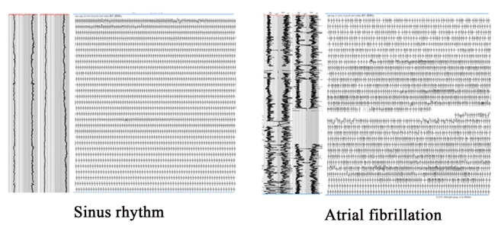
initial application
Hitoe was initially used for detecting signs of asymptomatic atrial fibrillation (AF)
Around 70% of ‘AF’ cases are asymptomatic at first
Long term ecg required to detect any early signs
Hitoe was tested on 100 volunteers of average age 52 years
Volunteers wore the t shirt 4 days a week for 2 months
10% of the young participants showed potential warnings of ‘af’

Slide 11
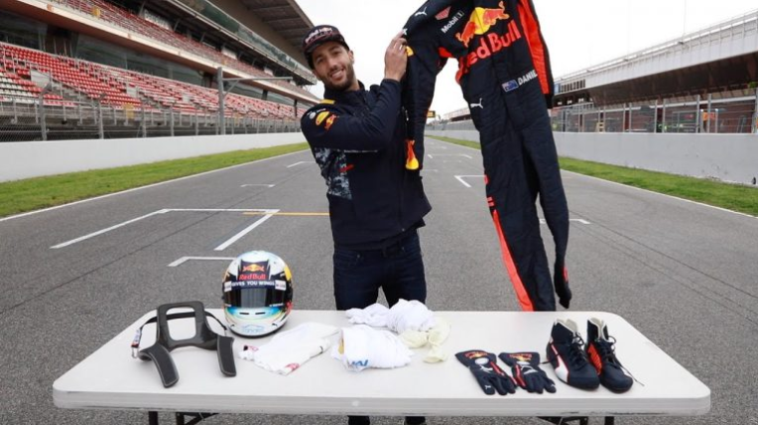
Hitoe for f1
Hitoe along with the small waveform transmitter can be easily worn as an inner layer (long sleeve top)
Drivers can report their ecg and other biomedical data without any invasive equipment
Thanks to iot, real time data will be constantly monitored by the team and any driver vital anomalies can be reported to the f1 staff

Slide 12
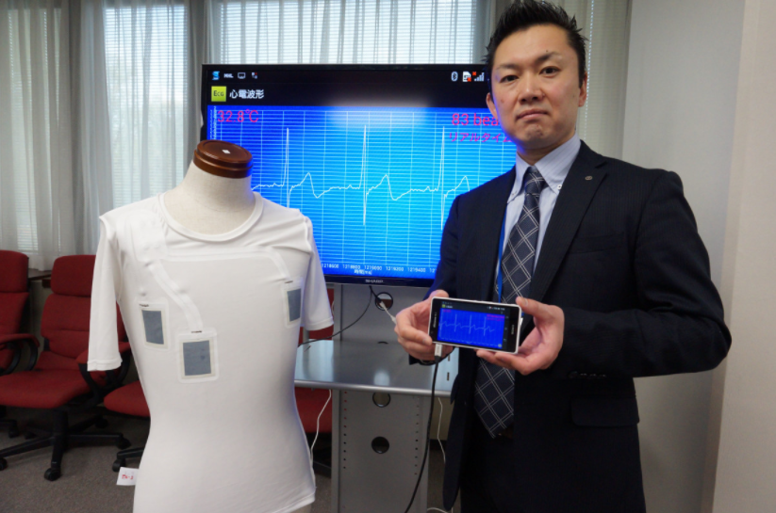
Applications for iot
Transmitter can report real time driver heart rate to the crew
information can be conveyed to any smart device screen via Bluetooth
Data can be received and used by pit crew, engineers, and medical staff
Mclaren f1 team tested this technology

Slide 13
2020 Bahrain grand prix crash
Romain grosjean from the ‘haas racing team’ had a terrible crash in f1 2020 in Bahrain
Car split in two and was engulfed in flames
Driver was stuck in the fire for over 2 minutes
Managed to survive with only first degree burns in his hands and feet

Slide 14
Future of f1 technologies
Implement multiple simultaneous biometric technologies for drivers
Focus on other health related driver statistics, such as vision, concussion, and bone or muscle damage
lighter and more breathable driver suits (already went from 1.3 kg to 800 grams over the last decade)
Iot will apply to all aspects of racing: driver vitals, fan experience, vehicle reports

Slide 15
conclusion
F1 will always be a dangerous sport
Important to focus on driver safety as much as vehicle technology
Biometrics not only help track live strain and stress on the driver, but also his condition during and after any accidents
Biometric technology has and will remain a hot topic in f1 driver suit technology: focus will be on faster data transfer rates with longer range and also lighter, breathable, and more fireproof technology
The right technology is a matter of personal preference of the driver and team

Slide 16
Thank you!

Slide 17
references
https://www.ntt-review.jp/archive/ntttechnical.php?contents=ntr201409ra1.html
https://us.nttdata.com/en/About-Us/Content/Wearable%20Tech%20for%20Better%20Health
https://www.nature.com/articles/s41598-019-48267-1
https://www.upcars.it/en/hitoe-mclarens-drivers-smart-t-shirt/
https://www.cosinuss.com/en/portfolio-items/koerperliche-belastung-in-der-formel-eins/#:~:text=On%20average%2C%20the%20fit%20heart,maintained%20over%20the%20whole%20duration.
https://www.essentiallysports.com/how-does-an-f1-driver-kit-differ-from-the-rest/
https://motorsport.tech/formula-1/f1-racewear-keeping-drivers-protected-over-the-decades

